Slide 1
Creating Custom Scripts for Spatial Projects

Slide 2
Table of Contents
Basics
-What does a Script do? Slide 3
-How do we add Scripts to Objects? Slide 4
-What are Visual Scripts? Slide 5
Creating Visual Scripts
-Adding a Visual Script to an Object Slide 7
-Writing your first Visual Script Graph Slide 9
-Spatial Nodes Slide 15
-Spatial Data Store Slide 17
Prefab Objects
-What are Spatial Prefab Objects? Slide 17
-Adding Prefab Objects to your Space Slide 22
-Creating custom Prefab Objects Slide 25
-Getting your Prefab Objects in a Space Slide 29

Slide 3
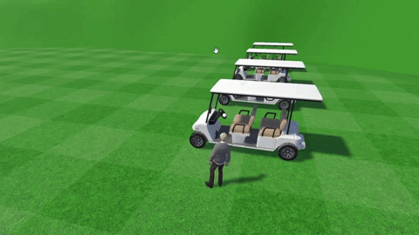
Basics What does a Script do?
Inside of your custom Spaces, you can have scripts attached to objects that customize the object's behavior.
For example, you can make objects move, clone themselves, have certain interactions with the user, and more.
Spatial's golf cart object in their Golf Cart Driving example scene. It can be driven using scripts.
Some slides will have additional information in the "Notes" section below. Look for the down arrow!
Notes:
Scripts can be extremely complex or extremely simple. This golf cart example is a more involved script, with many different "subscripts" that make it up.
You can find this golf cart example, and many others, in the Examples folder when using Spatial's scene template. For more information about this scene template, see my documentation on creating custom Spaces for Spatial (linked in the next slide).

Slide 4
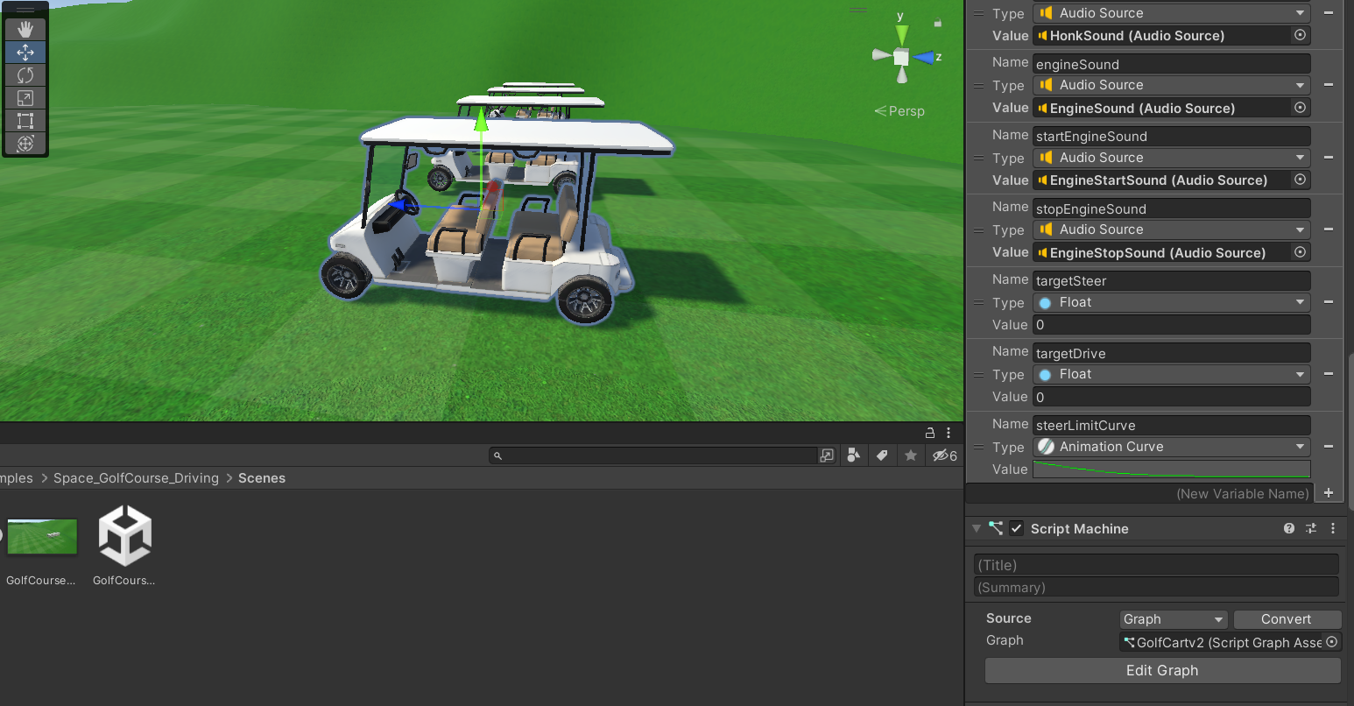
Basics How do we add Scripts to Objects?
Scripts must be added to objects inside of your Spatial project in Unity Editor.
To learn how to create Spatial projects in Unity, see my documentation on Creating Spaces.

Slide 5
Basics What are Visual Scripts?
"Visual Scripting" is a type of scripting that is created using nodes that are connected in a graph.
Spatial only supports visual scripting. C# scripts or scripts in other languages will not compile in Spatial*.
The visual script that is used for Spatial's golf cart, GolfCartv2.
Additional Notes Below
Notes:
Regularly in Unity, scripts can be made using visual scripts, but most commonly scripts are made using C#. Because of this, if you want to turn a pre-existing Unity project into a Spatial project, you may need to manually translate scripts from C# to a visual script. Otherwise, these C# scripts won't work as they do not compile to Spatial.
*Very recently, Spatial has announced that they will begin rolling out C# support in December of 2023! This is awesome, because it means that pre-existing Unity projects will be much, much easier to turn into Spatial projects.

Slide 6
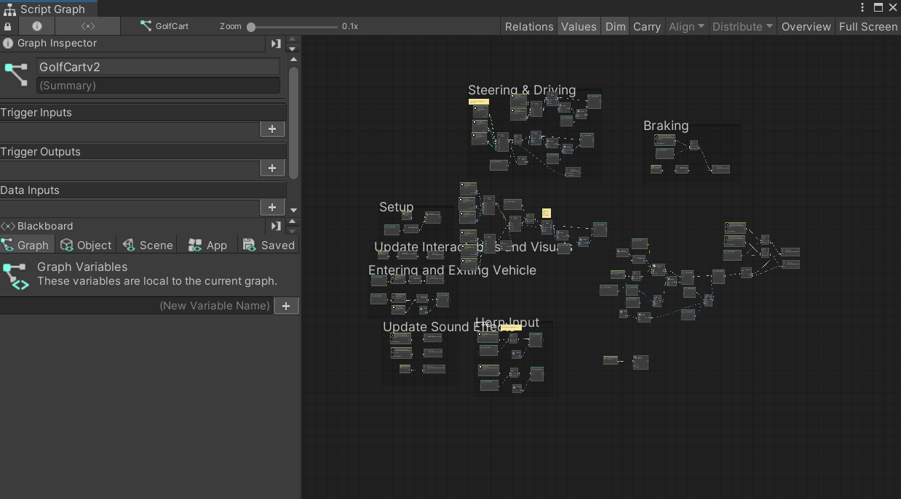
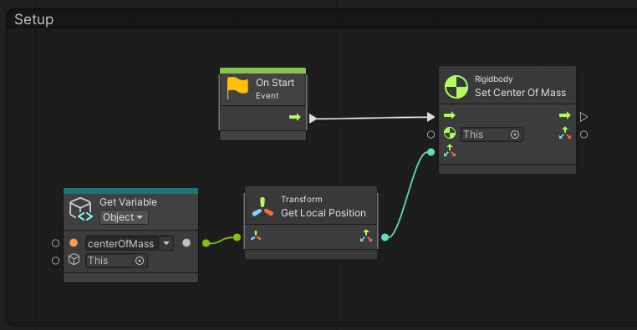
Basics What are Visual Scripts?
In a visual script, nodes represent objects, functions, events, or even other graphs.
Nodes are connected by lines, which determines the order that the nodes are processed.
Visual scripting graphs can be quite complicated or quite simple.
A small portion of GolfCartv2. On the start of the scene, we get the object variable centerOfMass and set the golf cart's center of mass to it.

Slide 7
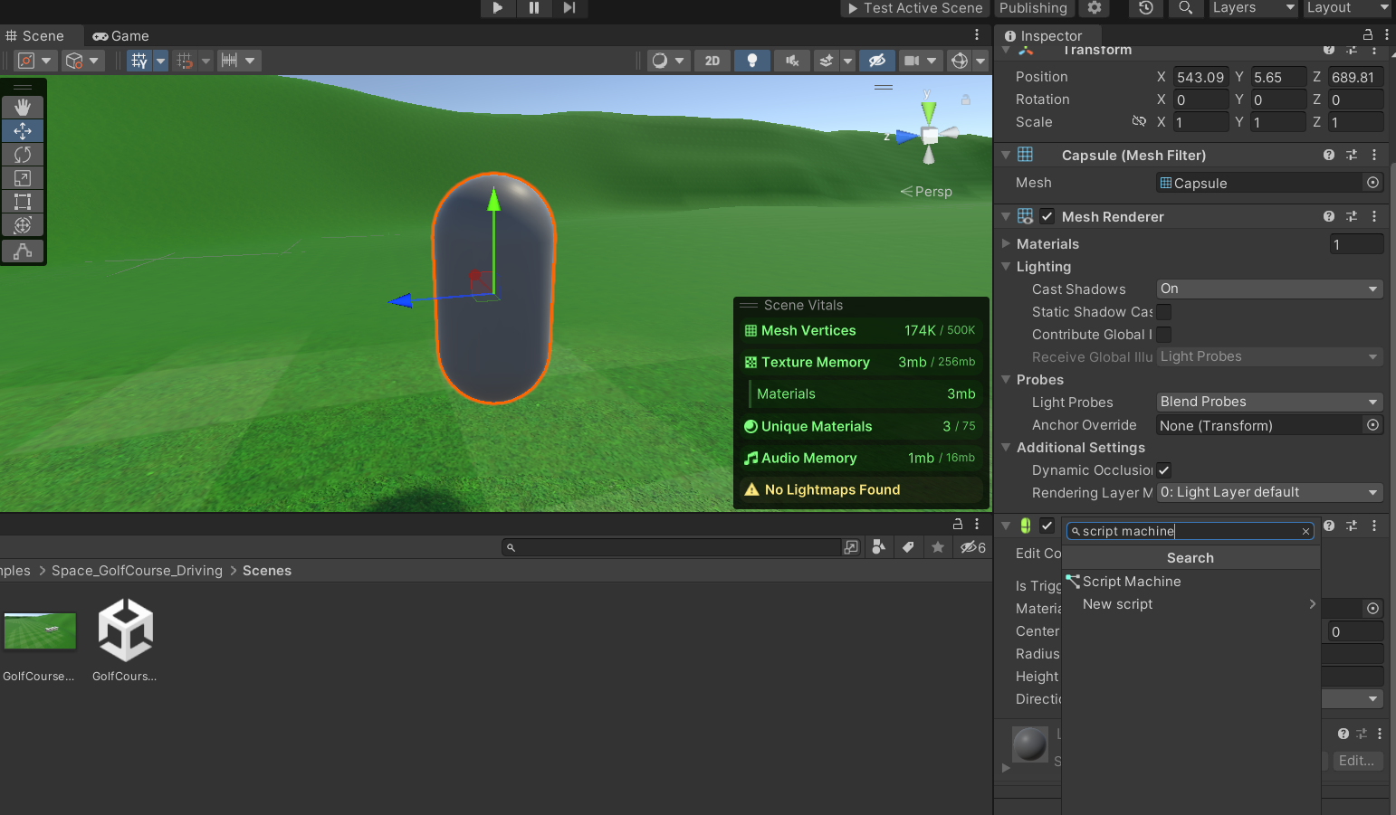
Creating Visual Scripts Adding a Visual Script to an Object
To give an object a new visual script, select the object in the Unity Editor.
In the Inspector, scroll down to Add Component. Search for "Script Machine" and select it.

Slide 8
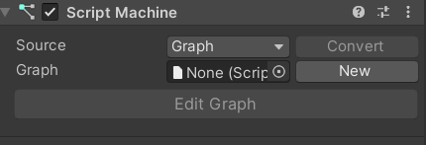
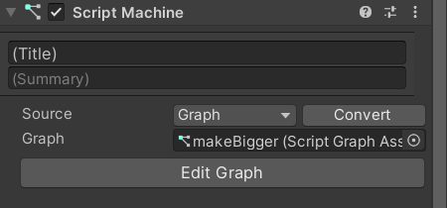
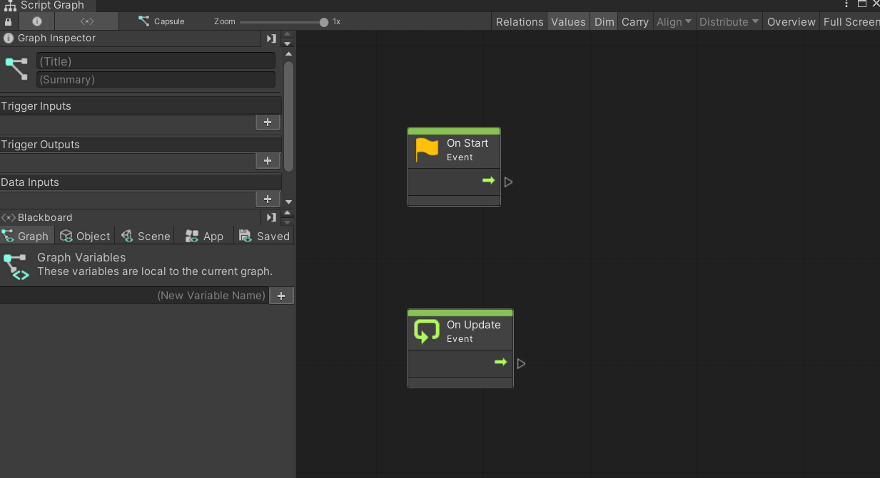
Creating Visual Scripts Adding a Visual Script to an Object
In your new Script Machine component, click "New" to create a new graph. After naming and saving it, click "Edit Graph".
This is where you can see and edit the graph of your visual script.

Slide 9
Creating Visual Scripts Writing your first Visual Script Graph
A new graph has two nodes. These are Event nodes, which are necessary for our script to do anything.
Different Event nodes are triggered during different events; For example, "On Start" simply triggers one time when the scene first loads. "On Update" triggers once every frame.
Additional Notes Below
Notes:
There are several types of nodes; Event nodes, function nodes, and literal nodes being the main ones. They are rather self-descriptive.
Event nodes act as a starting point for action in the graph. Each different event node "triggers" when a certain event takes place. For instance, the On Start event node triggers on the start of the scene. A "flow" proceeds from the event node's output, meaning essentially the course of action in the visual script graph. If you are familiar with C# scripting for Unity, event nodes are quite analogous to function headers such as Start() or Update().
Function nodes have a certain "function"; That is, they take a certain piece of data and do something with it. In the next few slides, we use the function node Debug Log, which prints a string literal to the console.
Literal nodes simply represent a literal piece of data. When we use the Debug Log function node, we must provide it with a string (a series of letters or words) to print, so we can use a string literal node and type whatever we want in it.

Slide 10
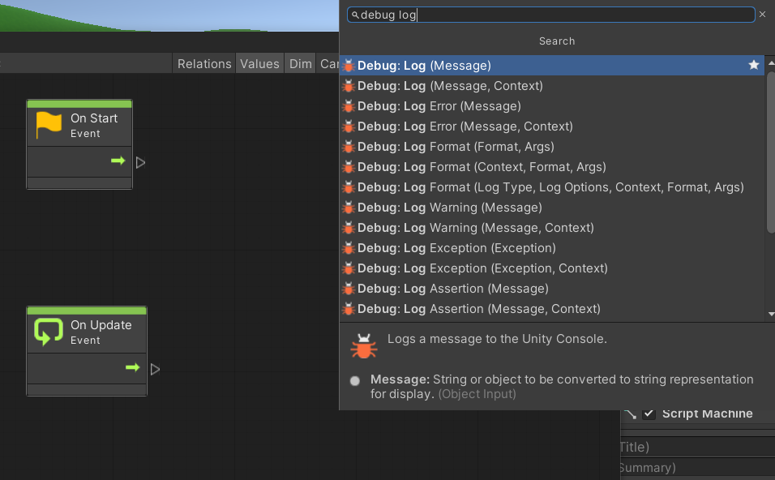
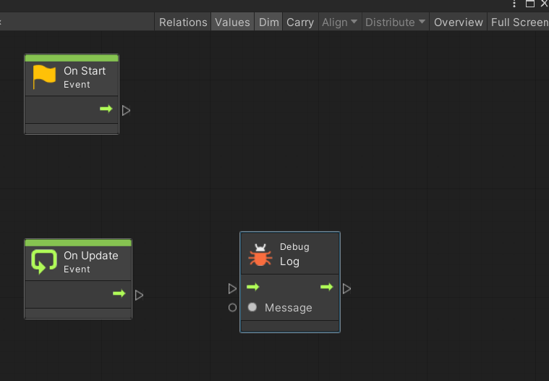
Creating Visual Scripts Writing your first Visual Script Graph
Functions are also essential for our visual script to do anything.
One of the best functions for testing your script is the Debug Log node.
To add a node to your graph, right click anywhere in the graph and search for the desired node.

Slide 11
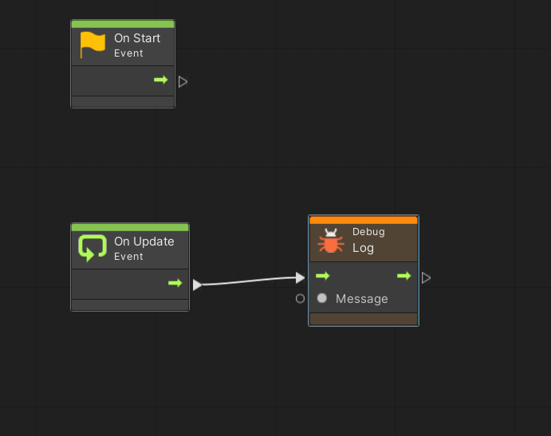
Creating Visual Scripts Writing your first Visual Script Graph
To connect two nodes together, you need to connect one node's Exit flow to another node's Invoke flow.
Click the triangle next to the arrow pointing outward from the first node, and then click the triangle next to the arrow pointing inward to the second node.

Slide 12
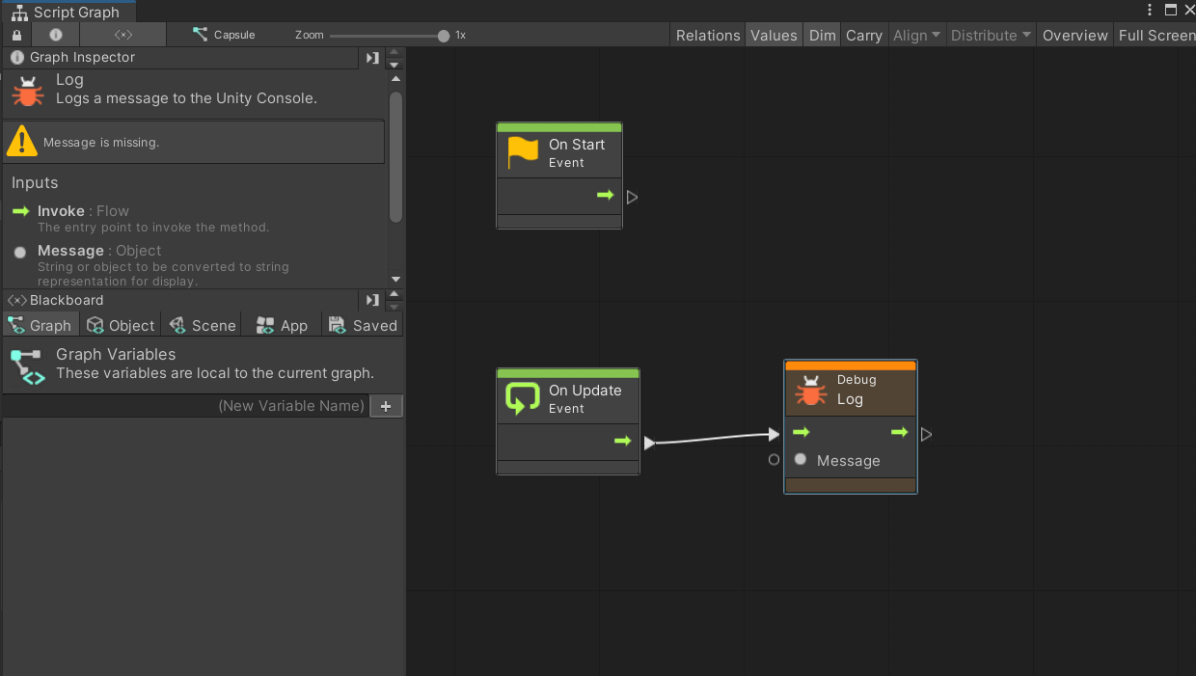
Creating Visual Scripts Writing your first Visual Script Graph
Our Debug Log node is orange now because it is invoked but is missing a required argument.
Clicking on a node will display any of its warnings, as well as inputs and outputs.
We can see that our Debug Log node is missing a Message object, which should be a string.

Slide 13
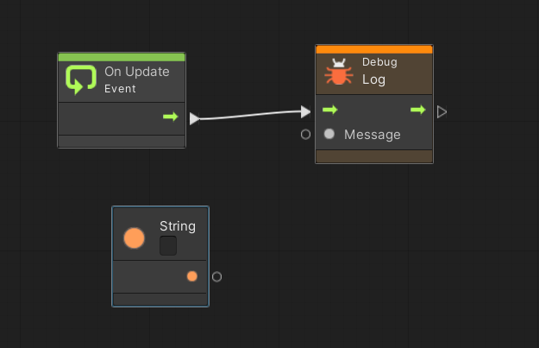
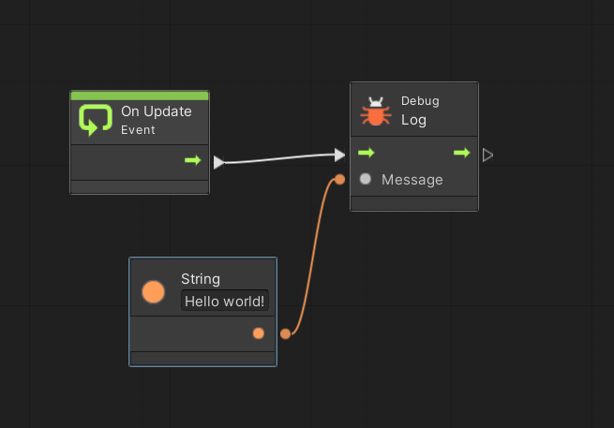
Creating Visual Scripts Writing your first Visual Script Graph
You can create a "literal" as a node. Right click and search for "String literal". You can write a string right inside the node.
Then, connect its output to the Debug Log node's input.

Slide 14
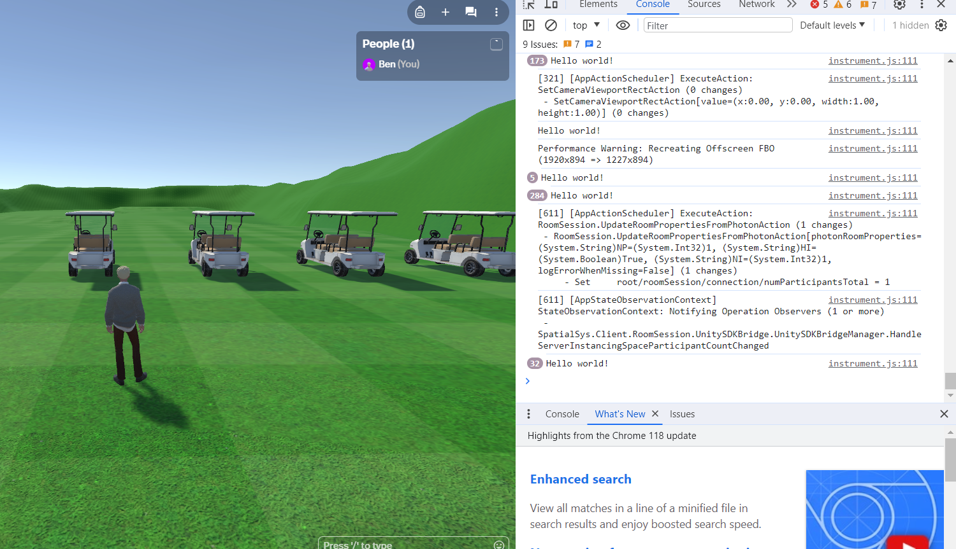
Creating Visual Scripts Writing your first Visual Script Graph
Now that we have an event and a function, we can see our visual script in action. Test the scene that your script is a part of.
To see messages printed by the Debug Log node, you must right click the sandbox page and click "Inspect". Then, change the view to Console mode.
There are tons of lines saying "Hello World!"-- our script is printing this message every frame.

Slide 15
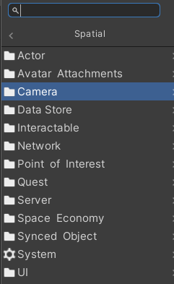
Creating Visual Scripts Spatial Nodes
Now we have seen an example of Event, Function, and Object nodes. It's also important to note that there are Spatial nodes.
These are nodes that are added to visual scripting by the Spatial SDK and are therefore not native to Unity like the other nodes.
Additional Notes Below
Notes:
The folder of nodes seen on the right can be pulled up by right clicking in your graph, and selecting the folder Spatial. Fair warning: for some reason, these folders do not contain all of the Spatial nodes available. The same is true when you simply search "Spatial" in the search bar after right-clicking. Hopefully this will be fixed in the future, as it makes it rather difficult to find the Spatial nodes you are looking for; For now, your best bet is to search for specific categories of Spatial nodes, which (most of them) are listed on the next slide.

Slide 16
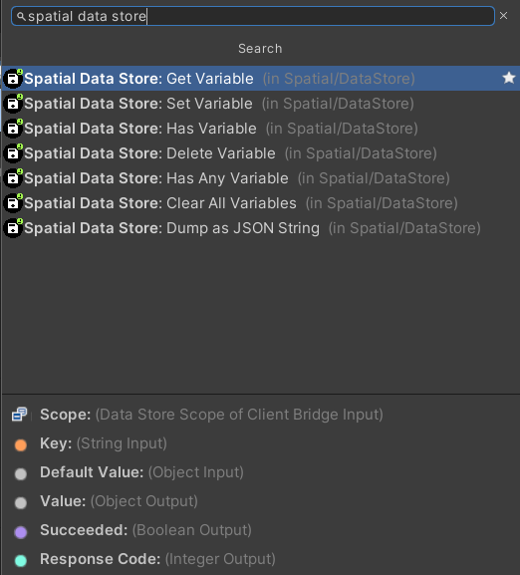
Creating Visual Scripts Spatial Nodes
Many of these Spatial nodes are incredibly useful, but they do not all show up when you just search "Spatial". Try searching for these:
Spatial Interactable
Spatial Input
Spatial Data Store
Spatial Sync
Spatial Synced Object
Spatial SFX
Spatial Quest
Spatial System
Spatial UI
Spatial Data Store has some incredibly useful nodes which we will look at shortly.

Slide 17
Creating Visual Scripts Spatial Data Store
The category of Spatial nodes called Spatial Data Store can be incredibly useful.
Using these nodes, you can make global variables in your Space. Meaning, different objects in the Space can access and change these variables.
Normally, Unity has Scene Variables that serve the same purpose, but for certain cases* in Spatial these Scene Variables are unusable.
(Important!) Additional Notes Below
Notes:
*What are these certain cases?
Well, regular Unity scene variables are usable between regular objects when you bounce your scene to Spatial. However, say you had a script that was attached to a Spatial Prefab Object (these objects are covered in this documentation soon). Prefab Objects cannot access these Unity scene variables. Presumably this is because Prefab Objects are entities outside of the actual scene; A "Space" and a "Prefab Object" are separate packages after all.
On the other hand, Spatial Data Store nodes can make and manipulate variables that are accessible by scripts inside of Spatial Prefab Objects. Hooray!
There are limitations to these Spatial Data Stores however. At the moment they are mostly meant only to store user data (the variables stored are unique to each user). Read more about the Spatial Data Store and its limitations here: https://docs.spatial.io/data-store
Note: In order to use a Spatial Data Store node, it must follow a flow that proceeds from a coroutine event. This is easy to set up; You can simply toggle on the "Coroutine" option on any event node.

Slide 18
Creating Visual Scripts Spatial Data Store
The main limitations of Spatial Data Store are its storage size and how often it can be updated.
At the moment, it can only hold 1 megabyte, and it can only be updated 10 times per minute.
The warning that occurs when you exceed the Data Store edit rate limit

Slide 19
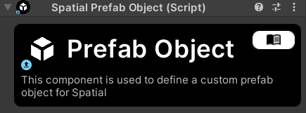
Prefab Objects What are Spatial Prefab Objects?
Spatial offers a different package type other than a Space or a World.
Spatial Prefab Objects (not to be confused with Unity Prefabs) are a type of object that should be familiar to anyone who has used Spatial before.
Additional Notes Below
Notes:
"Unity Prefabs" denote a type of object in Unity that can be duplicated and modified as a collective; When you make a modification to a Unity prefab, all instances of that prefab are modified as well. Read more about Unity prefabs here: https://docs.unity3d.com/Manual/Prefabs.html
Spatial Prefabs, on the other hand, are a type of Spatial package. Other packages include Spaces, Avatars, Avatar animations, and more. We will discuss more about what Spatial prefabs do in the next few slides.

Slide 20
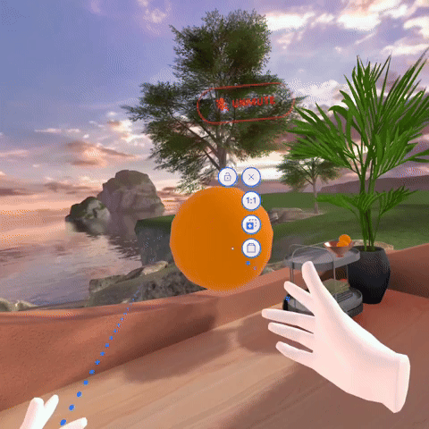
Prefab Objects What are Spatial Prefab Objects?
If you have used Spatial before, several good examples of Prefab objects can be found right in your Home Space.
The Spatial Prefab Object of an orange in your Home Space

Slide 21
Prefab Objects What are Spatial Prefab Objects?
In short, a Spatial Prefab Object uses a script of Spatial's design to have a certain interactability for the user when it is deployed in a Space.
All Prefab Objects have the same UI, interactability, and controls.
The Spatial Prefab Object that represents in orange in your Home Space

Slide 22
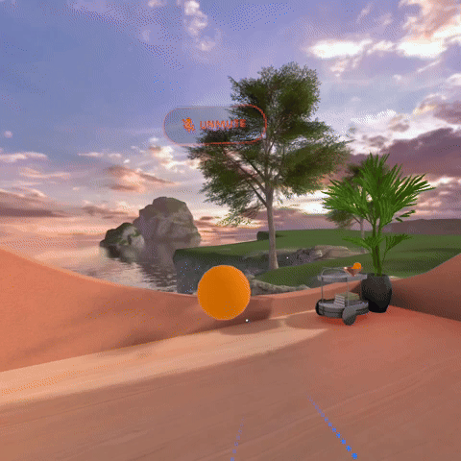
Prefab Objects What are Spatial Prefab Objects?
Spatial Prefab Objects allow you to:
-Move them
-Resize them
-Rotate them
-Hold them
-Duplicate and delete them
-Pin them in place
-Script them
Duplicating and resizing the orange

Slide 23
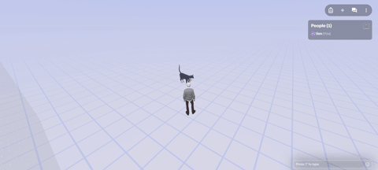
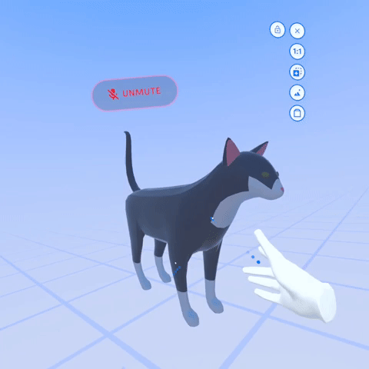
Prefab Objects What are Spatial Prefab Objects?
Note that interacting with Spatial Prefab Objects is naturally quite different between the browser version and the Oculus version.
Interacting with a cat Prefab on browser
Interacting with a cat Prefab on Oculus

Slide 24
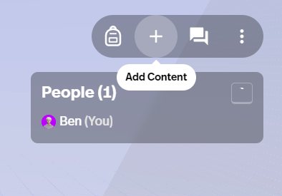
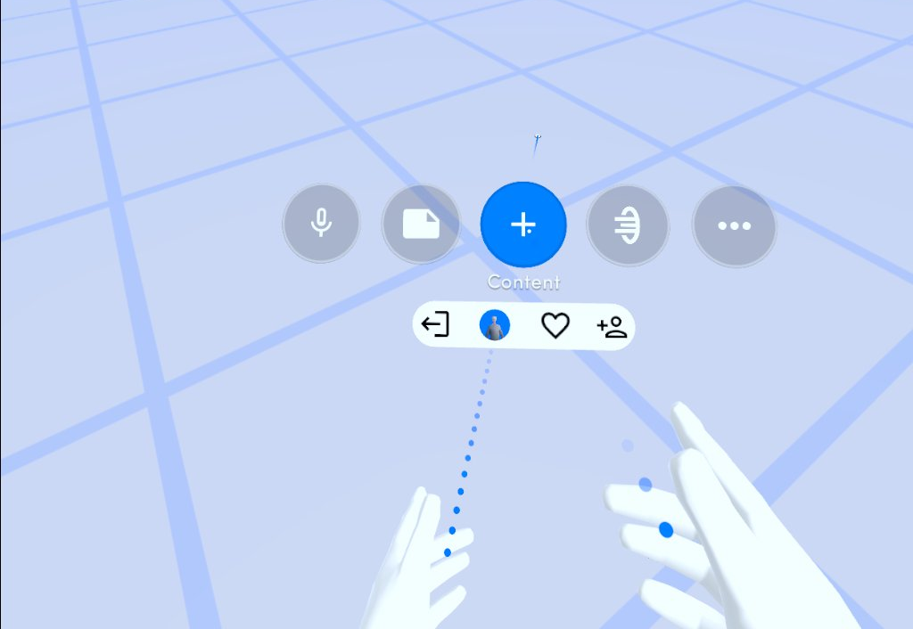
Prefab Objects Adding Prefab Objects to your Space
To add a Spatial Prefab Object to your Space, first enter the Space in either browser or Oculus.
You can then open your Add Content menu (top right UI + sign on browser, bottom UI + sign on Oculus).
Browser UI
Oculus UI

Slide 25
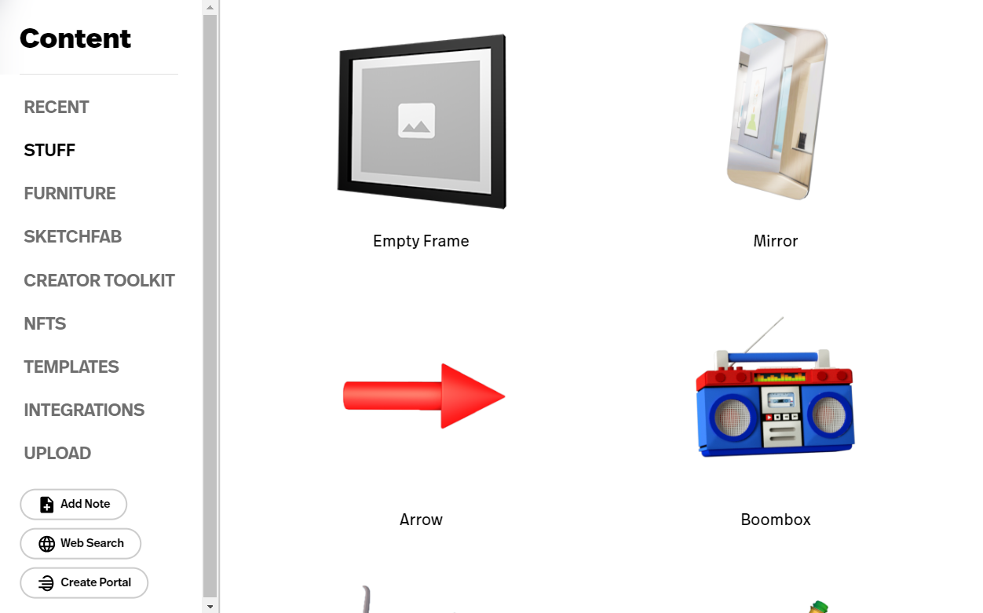
Prefab Objects Adding Prefab Objects to your Space
From the Add Content menu, you can add Prefab Objects from various different sources.
For example, Spatial has some Prefab Objects for you under "Stuff" and "Furniture".
You can also pull Prefab Objects directly from Sketchfab.

Slide 26
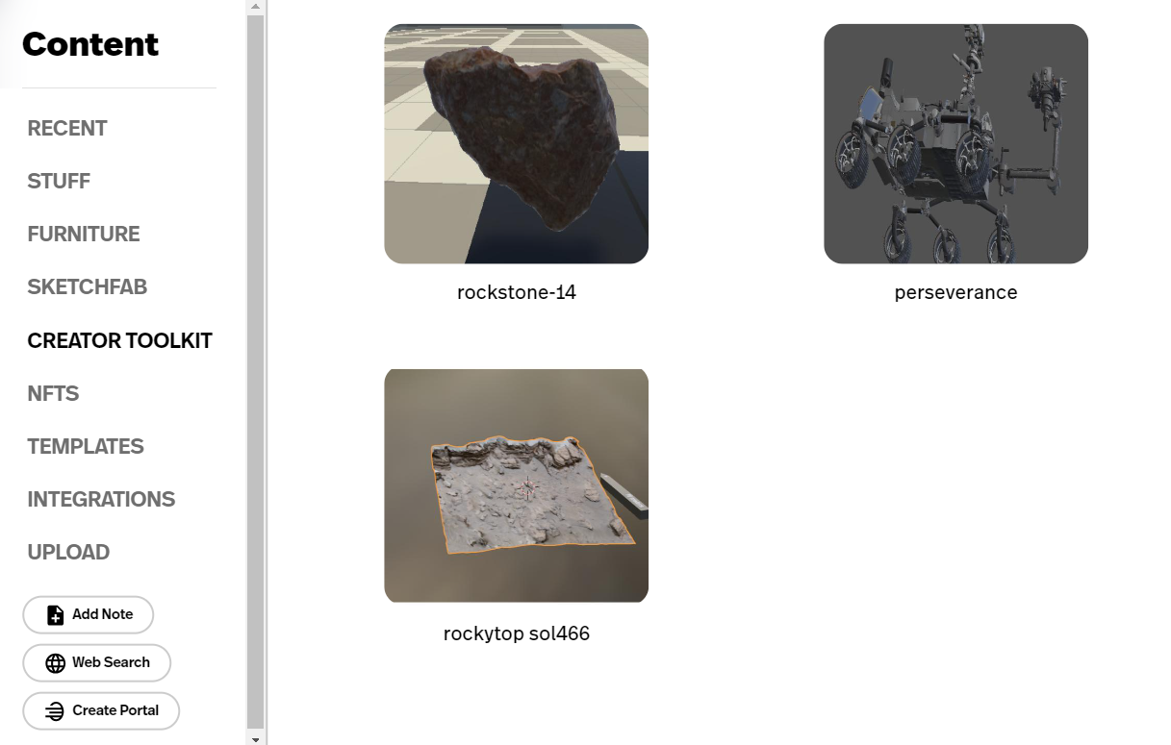
Prefab Objects Adding Prefab Objects to your Space
Under "Creator Toolkit", you can find custom Prefab Objects that you have published.
We will cover that process next.

Slide 27
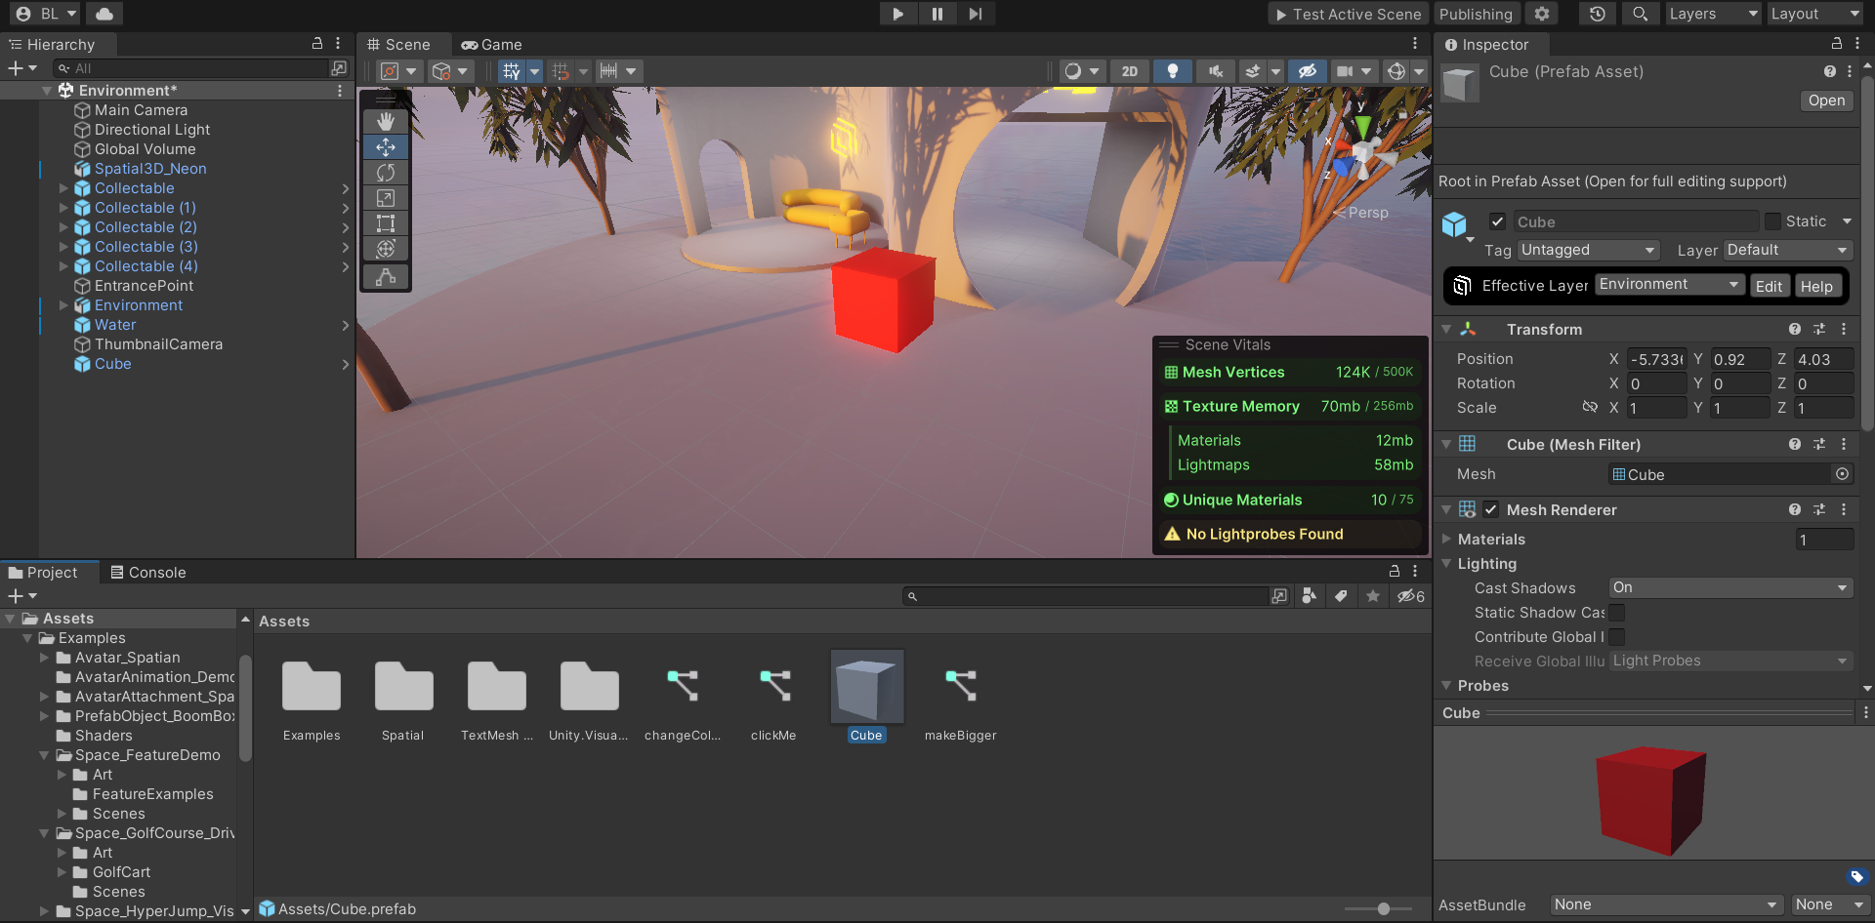
Prefab Objects Creating custom Prefab Objects
Creating a custom Prefab Object is as easy as adding a component to your desired object in Unity Editor.
Open any Unity project set up for Spatial and create your desired object as a Unity Prefab.
To do this simply drag your object somewhere into the Assets directory at the bottom.
Unity Prefabs are blue in the Hierarchy.

Slide 28
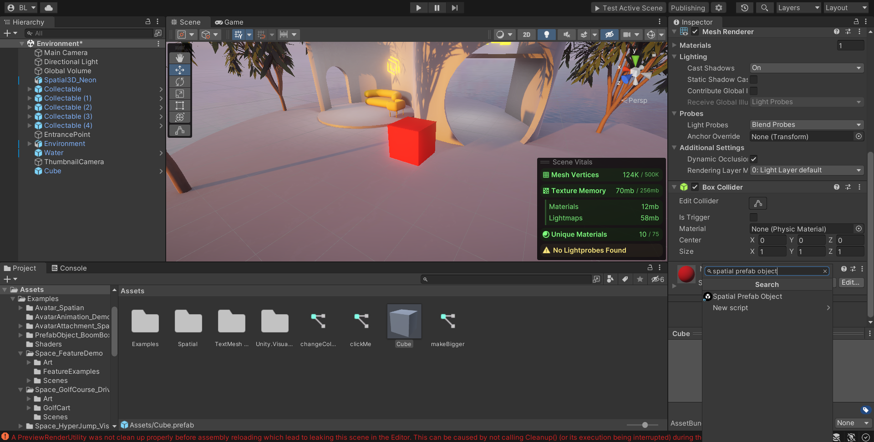
Prefab Objects Creating custom Prefab Objects
Now, add a new component to your Unity Prefab.
Make sure to select the Prefab parent in your Assets directory (not an instance of the Prefab in your scene).
Search for "Spatial Prefab Object" and select it.

Slide 29
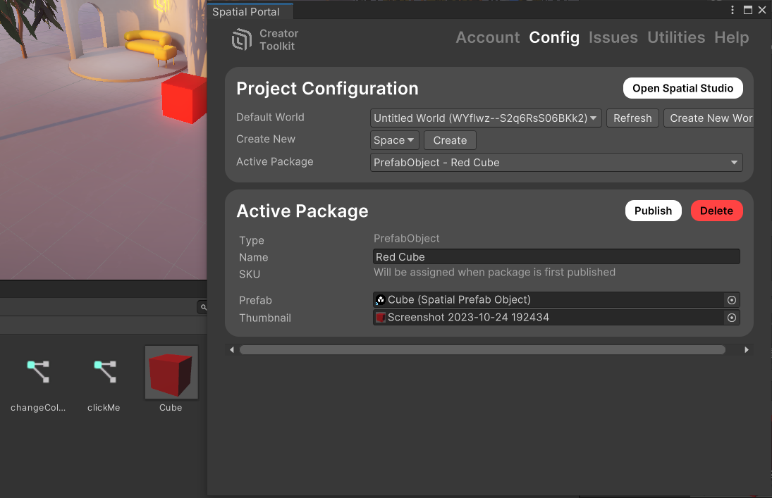
Prefab Objects Creating custom Prefab Objects
Drag the Spatial Prefab Object from your Assets directory to the Prefab input.
Name your Prefab Object accordingly, and create a (512x512) thumbnail for it.
Then, click "Publish".

Slide 30
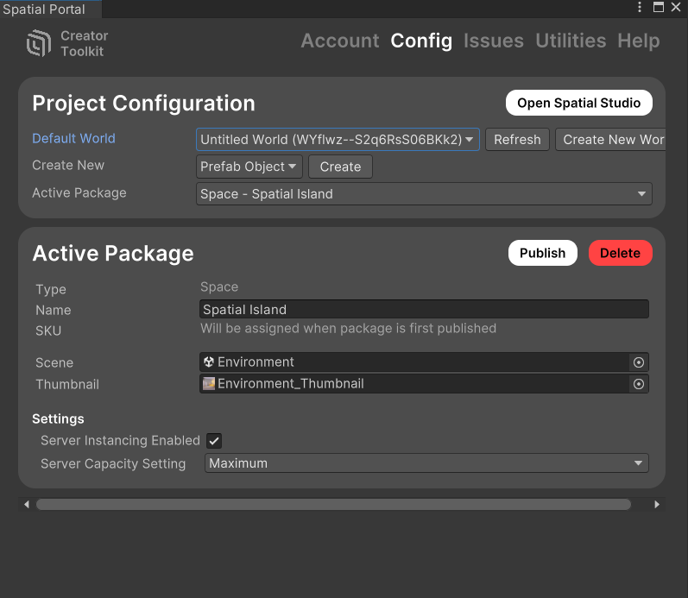
Prefab Objects Creating custom Prefab Objects
The last step is to publish your Prefab Object package to Spatial.
In the top menu, click "Publishing". Select any World.
Next to "Create New", select "Prefab Object" and click "Create".

Slide 31
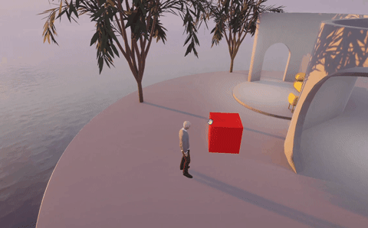
Prefab Objects Getting your Prefab Objects in a Space
Go ahead and delete any instances of the Spatial Prefab Object in your scene.
When you bounce your scene to Spatial, any instances of Prefab Objects already in the scene will not instantiate as Prefab Objects.
A Prefab Object that you naively put in your scene before publishing will not have any of the functionality of a Prefab Object.

Slide 32
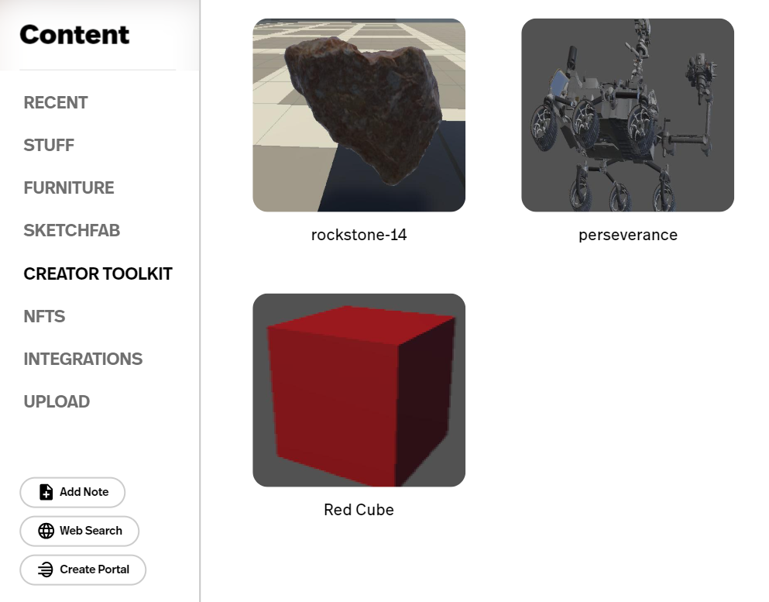
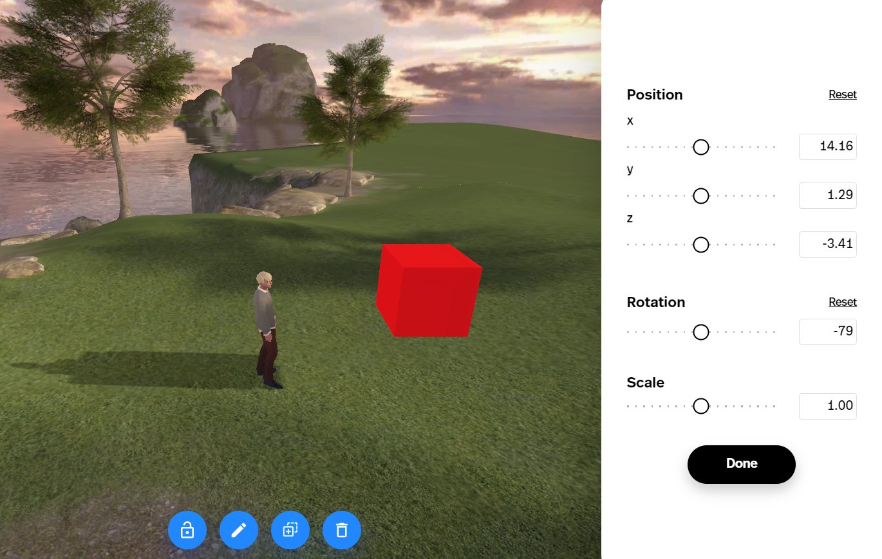
Prefab Objects Getting your Prefab Objects in a Space
To see your custom Prefab Object in a Space, you have two options.
1: For any pre-existing Space you can add content to, you can add your custom Prefab from the Add Content menu. Look for it in the "Creator Toolkit" tab.

Slide 33
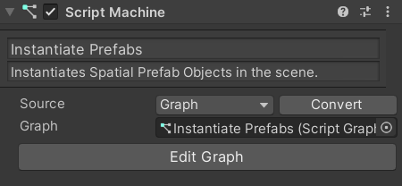
Prefab Objects Getting your Prefab Objects in a Space
2: In any existing Spatial project, you can instantiate Prefab Objects using a visual script in Unity.
This is more complicated, but it is the only way to have a Space loaded with Prefab Objects automatically.

Slide 34
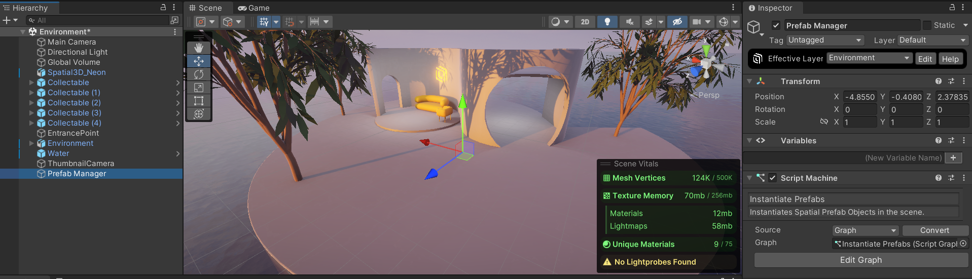
Prefab Objects Getting your Prefab Objects in a Space
For a script that instantiates Spatial Prefab Objects, it is best practice to apply it to an empty object in the scene, called something like "Prefab Manager". This way, we can better organize our scripts.

Slide 35
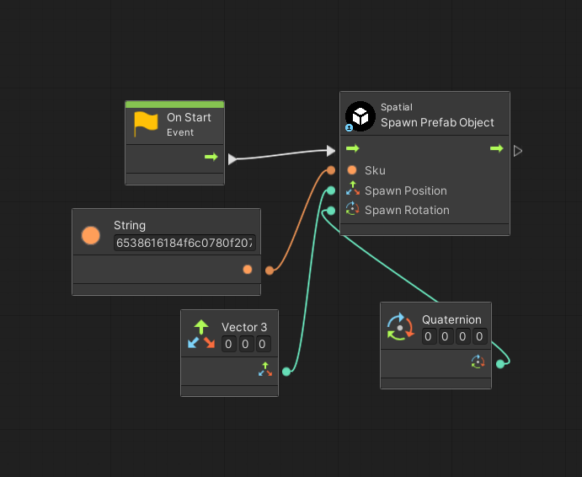
Prefab Objects Getting your Prefab Objects in a Space
Inside the graph, you can add a node called "Spatial: Spawn Prefab Object". It asks for a SKU code, which is generated for each Prefab Object when it is published for the first time.
Find this code by clicking "Publishing" and then selecting your Prefab Object, or you can find it here.

Slide 36
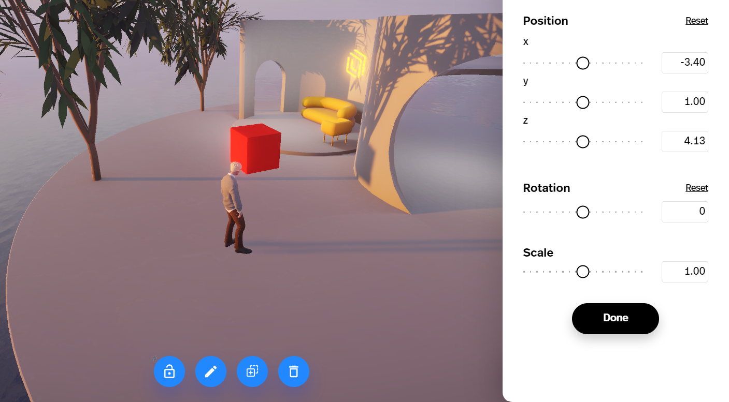
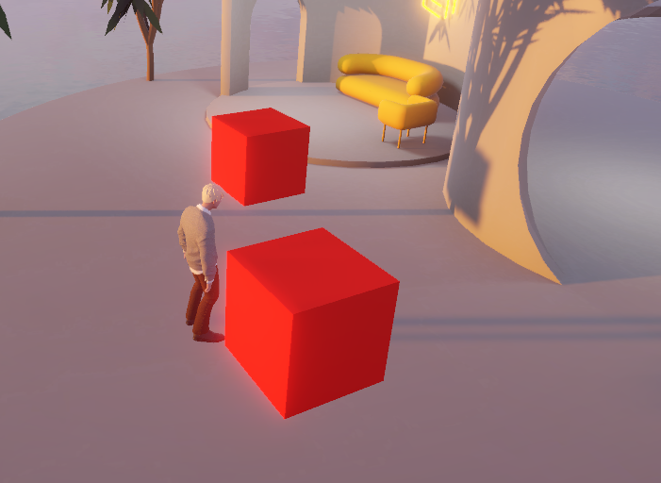
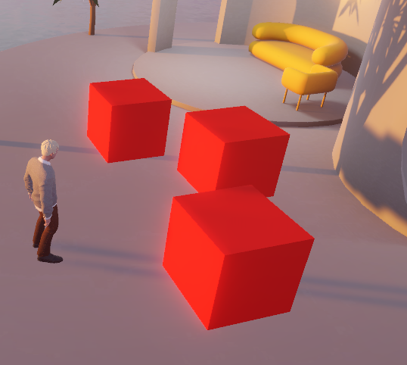
Prefab Objects Getting your Prefab Objects in a Space
Now our Spatial Prefab Object instantiates in our Space every time it is started.
Starting your room doesn't delete all the Prefabs, so restarting multiple times can result in multiple copies of the Prefab.
Deal with this as you see fit (perhaps your script deletes all Prefab Objects before it instantiates any).
?
Clicking "Test Active Scene" will trigger the On Start event. Therefore, testing 3 times will result in 3 On Start triggers.

Slide 37
Prefab Objects Prefab Objects Limitations
Prefab Objects cannot use Unity's scene variables.
Therefore, in order to make variables that are global for Prefab objects, we need to make use of the Spatial Data Store script nodes.
For more information about Spatial Data Store, go back to slide 17 or visit Spatial's documentation.

